Slide 1


KNOWLEDGE INSTITUTE OF TECHNOLOGY Department of Electrical and Electronics Engineering
Final Project Review
Course Code : EE8611 Course Name : Mini Project
Prepaid Energy Meter with Smart Monitoring System
Batch Number : II
Sivasankar C 611220105033
Dinesh Kumar P 611220105008
Jayaganth T 611220105015
Ravinthar P 611220105027
Thirumalai V 611220105041
Sanjay M K 611220105314
TEAM MEMBERS
PROJECT SUPERVISOR
Dr.P.A.Gowrisankar,
Associate Professor
Department Of Electrical & Electronics Engineering
KIOT, Salem

Slide 2
Project Category
In-house
Field of the Project:
Embedded System
&
IOT

Slide 3
Abstract
Energy is very precious for the living beings in recent times. The Energy consumption is consistently as increases as the population increases so the need power is also increases, the revenue in electricity system are increasing and also gets hard to monitoring the each system. It is quite impossible to check out the consumer’s residence at regular intervals. In this project, a new procedure of using NODE MCU to monitor and control the energy meter power supply by remotely disconnect and reconnecting the service of a particular consumer. A notification is sent to the utility central server and consumer through Wi-Fi module whenever the load consumption is exceeding the consumer desired value. The NODE MCU and WEB page handle the Billing difficulties, Real-time Monitoring the load consumption.
Keywords—IOT, Smart Monitoring, Prepaid System

Slide 4
Literature Survey 1 (Base Paper)
Name of the Journal & Year of Publication | International Conference for Convergence in Technology (I2CT) 2017
Title of the paper | Smart Energy Metering and Power Theft Control using Arduino & GSM
Abstract (Keywords) | GSM, power theft, Smart meter, Nontechnical losses, power monitoring, tampering, automatic billing.
Hardware Used | digital energy meter, an Arduino (microcontroller), GSM modem and SSR
Software Used | Arduino IDE
Applications | Single phase Energy meters
Future scope of work | Three Phase Energy meters

Slide 5
Literature Survey 2
Name of the Journal & Year of Publication | International Conference on Power, Energy and Control (ICPEC) 2013
Title of the paper | A Smart Prepaid Energy Metering System to Control Electricity Theft
Abstract (Keywords) | Keywords-electricity theft; prepaid meter; GSM networks; SMS; smart energy mete
Hardware Used | microcontroller (AT mega 32), energy measuring chip (ADE7751), GSM module , MAX232, current transformers, potential transformers, LCD display and a relay
Software Used | Arduino IDE
Applications | Prepaid method of electricity usage
Future scope of work | Control of Electricity Theft using Observer Meter

Slide 6
Literature Survey 3
Name of the Journal & Year of Publication | Institute of Electrical and Electronics Engineers(IEEE) 2019
Title of the paper | Arduino Based Smart Energy Meter using GSM
Abstract (Keywords) | Smart Energy Meter (SEM), Arduino, GSM, SMS
Hardware Used | Energy Meter, Microcontroller (Arduino), Light Dependent Resistor (LDR), GSM Shield, LCD, Relay, Real Time Clock(RTC)
Software Used | Proteus 8.0, Arduino IDE
Applications | Energy monitoring
Future scope of work | Energy theft detection

Slide 7
Literature Survey 4
Name of the Journal & Year of Publication | Institute of Electrical and Electronics Engineers(IEEE) 2017
Title of the paper | Development of an Internet Based Prepaid Energy Meter
Abstract (Keywords) | Internet of Things, Energy Meters, HTML5, ESP8266, Microcontroller
Hardware Used | microcontroller (AT mega 32), energy measuring chip (ADE7751), GSM module , MAX232, current transformers, potential transformers, LCD display and a relay
Software Used | Proteus, Arduino IDE
Applications | Energy measuring
Future scope of work | Energy monitoring

Slide 8
Literature Survey 5
Name of the Journal & Year of Publication | International Journal of Engineering Science and Computing(IJESC) 2018
Title of the paper | Smart Energy Meter
Abstract (Keywords) | GSM, Power Consumption, Billing, Smart Electricity meter
Hardware Used | Arduino, GSM Modem, ENERGY METER, OPTOCOUPLER, LCDDISPLAY Potentiometer
Software Used | Arduino IDE, Proteus 8.0
Applications | Energy Monitoring
Future scope of work | Energy Theft Detection

Slide 9
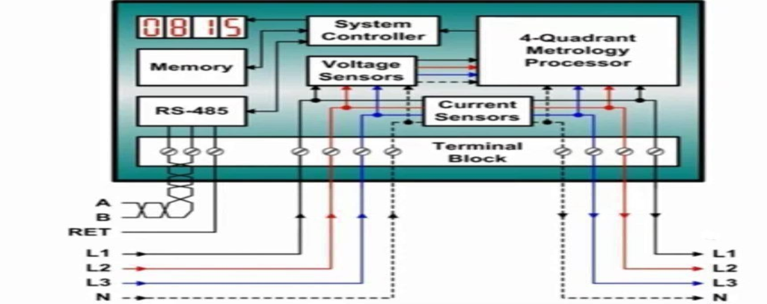
Block Diagram Of Existing Method
As the Power supplied from line in left side and power delivered to the load in right side the power consumed will be monitored and displayed in LED Display and the data will be calculated and stored in the Processor.

Slide 10
Existing Method (Problem Area & Identification)
The customer faces several issues as a result of post- paid connections.
Traditionally, the electricity meters are installed on consumer’s premises and the consumption information is collected by meter-readers on their monthly visits to the premises.
There is no system to monitor the load usage in the existing system. So, the consumer faces economic problems during post billing period.

Slide 11
Proposed Method (Objective’s)
To obtain the pre-paid recharge system for the existing energy meters.
To develop a module to monitor the load consumption.
To enable two-way communication between consumer and the provider.
To create user friendly platform to monitor the real time status of the Energy meter.

Slide 12
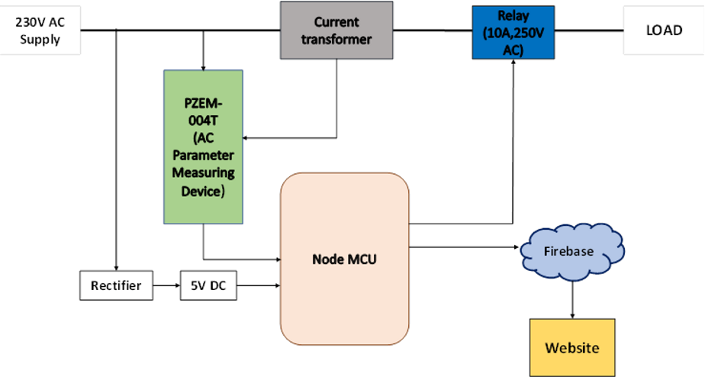
Proposed System Block Diagram

Slide 13
Proposed Hardware & Software description
HARDWARE PURCHASED
Node MCU Module
PZEM-004T Module
10 A 250V AC Relay
Lamp
SOFTWARE USED
Arduino IDE
Firebase server

Slide 14
Methodology / Working principle
Hardware setup:
Connect the PZEM004T module and Node MCU using appropriate jumper wires as per the pinouts. Connect the Power supply to the PZEM004T module.
Software setup:
Install the required software components, such as the Arduino IDE and libraries for the PZEM004T module and Node MCU.
Calibration:
Calibrate the PZEM004T module by following the calibration procedure. This step is necessary to ensure accurate measurement of the energy consumed.

Slide 15
Code implementation:
Write the code to read the energy consumption data from the PZEM004T module and store it in a database or a cloud platform. Implement the logic for prepaid energy meter functionality, such as deduction of energy credits for each unit consumed, alerting the user when the credit is running low, and disabling power supply when the credits are exhausted.
User interface:
Develop a user interface, such as a mobile app or a web application, to enable the user to view the energy consumption data, recharge the credits, and monitor the usage.
Testing:
Test the system thoroughly to ensure that it meets the requirements and functions as expected. Make necessary modifications and improvements based on the testing results.

Slide 16
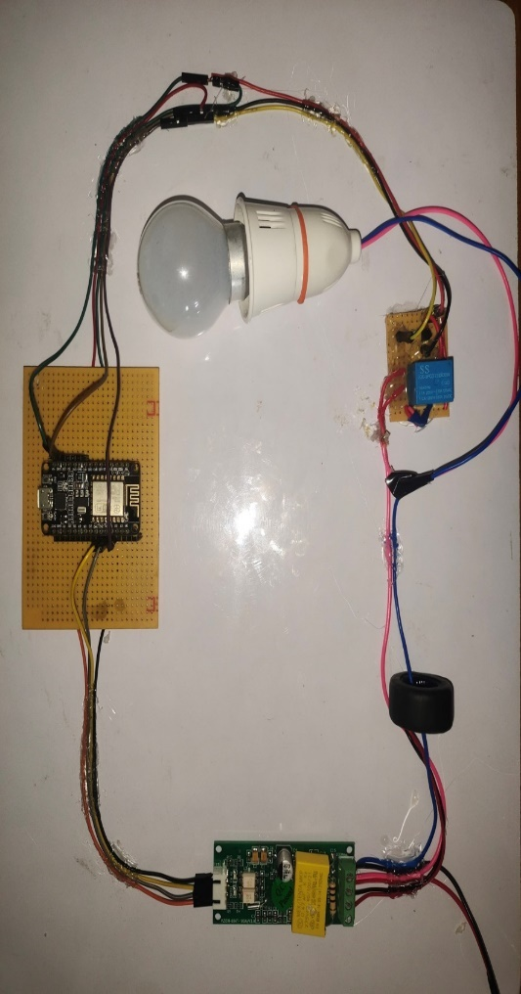
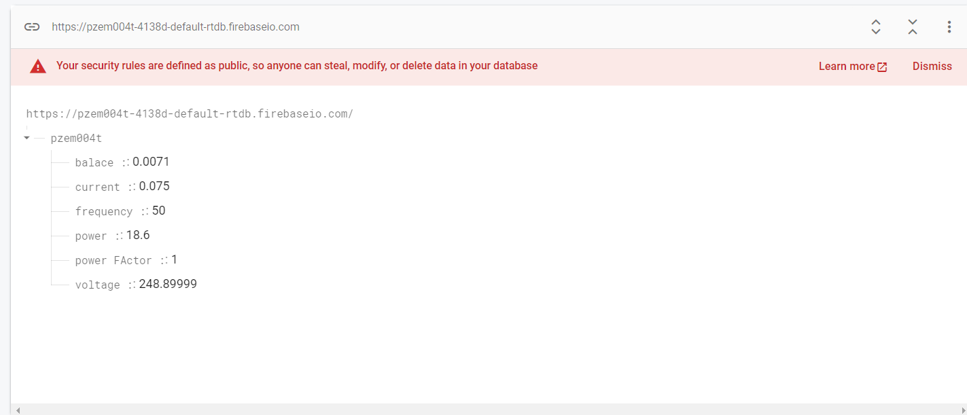
Results & Discussion (Hardware)
Hardware Setup
Firebase Output

Slide 17
Results & Discussion (Hardware)
Table 1
Table 2
With Balance
Without Balance
S.No | Parameters | Value | Units
1 | Voltage | 247.00 | Volts
2 | Current | 0.07 | Amps
3 | Power | 17.40 | Watts
4 | Frequency | 50 | Hz
5 | Balance | 0.3 | Rs
S.No | Parameters | Value | Units
1 | Voltage | 247.10 | Volts
2 | Current | 0.08 | Amps
3 | Power | 18.40 | Watts
4 | Frequency | 50 | Hz
5 | Balance | 0.0 | Rs
Discussion
The below Table1 shows the output of system with remaining balance. The factors such as voltage, current, power, frequency, balance can be viewed in a dynamic website and the real-time data will be transferred to the firebase
The above Table 2 shows the output of system without remaining balance. The factors such as voltage, current, power, frequency of the previous state can be viewed in a dynamic website and the real-time data will be transferred to the firebase

Slide 18
Conclusion and Future Scope
Conclusion
As the world transitions towards cleaner and more sustainable energy sources, prepaid energy meters using NodeMCU and PZEM004T can play a key role in promoting energy efficiency and conservation. By providing real-time information on energy usage and encouraging users to monitor and manage their energy consumption, these systems can help reduce overall energy demand and minimize the environmental impact of energy use.
Future Enhancements
As a future scope, the system can be further enhanced by incorporating features such as automatic load shedding during peak hours, integration with renewable energy sources, and remote monitoring and control of energy consumption. As such, the development and deployment of prepaid energy meters using Node MCU and PZEM004T offer a promising path towards a more sustainable energy.

Slide 19
Publication Details
International Journal
Dr.P.A.Gowrisankar,M.E.,Ph.D.,P.Dinesh Kumar, T.Jayaganth, P.Ravinthar, C.Sivasankar, V.Thirumalai, M K.Sanjay, published a paper on the title of “SMART PREPAID ELECTRIC ENERGY METER MONITORING SYSTEM USING MACHINE LEARNING AND INTERNER OF THINGS(IoT)” in International Journal of Recent Trends in Multidisciplinary Research(IJRTMR) May-June 2023, Vol3(3), 01-05, ISSN No: 2583 0368.

Slide 20
Thank You

